Slide 1
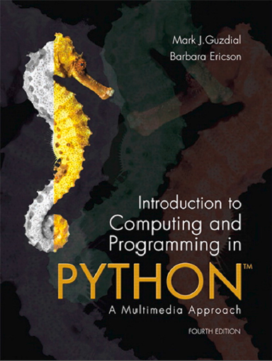
Introduction to Computing and Programming in Python™: A Multimedia Approach
Fourth Edition
Chapter 8
Modifying Samples in a Range
Copyright © 2016, 2013, 2010 Pearson Education, Inc. All Rights Reserved
Notes:
If this PowerPoint presentation contains mathematical equations, you may need to check that your computer has the following installed:
1) MathType Plugin
2) Math Player (free versions available)
3) NVDA Reader (free versions available)

Slide 2
Learning Objectives
8.1 To splice sounds together to make sound compositions.
8.2 To reverse sounds.
8.3 To mirror sounds.
8.4 To iterate an index variable for an array across a range.
8.5 To use comments in programs and understand why.
8.6 To identify some algorithms that cross media boundaries.
8.7 To describe and use scope more carefully.

Slide 3
Knowing Where We are in the Sound
More complex operations require us to know where we are in the sound, which sample
Not just process all the samples exactly the same
Examples:
Reversing a sound
It’s just copying, like we did with pixels
Changing the frequency of a sound
Using sampling, like we did with pixels
Splicing sounds

Slide 4
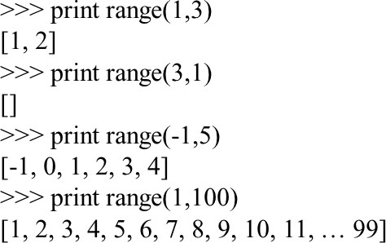
Using for to Count with Range

Slide 5
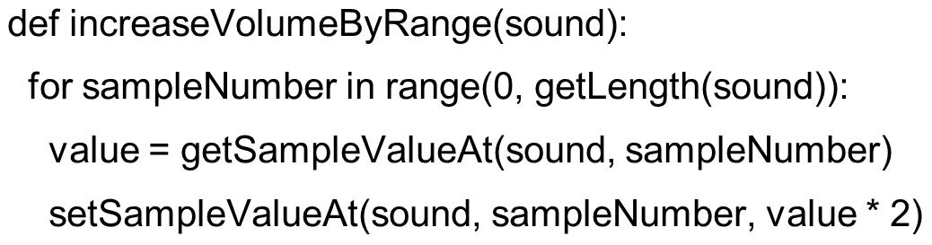
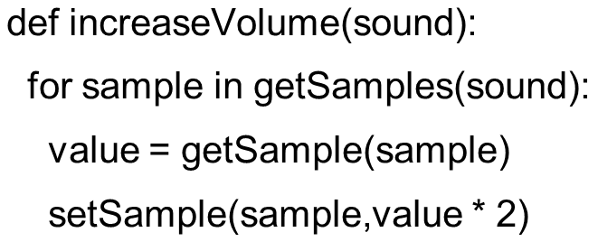
Increasing Volume by Sample Index
This really is the same as:

Slide 6
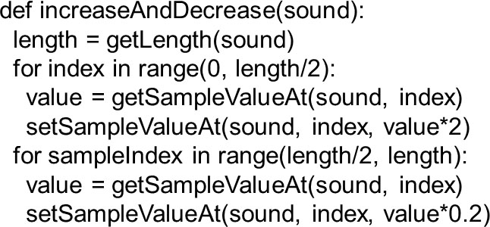
Modify Different Sound Sections
The index lets us modify parts of the sound now - e.g. here we increase the volume in the first half, and then decrease it in the second half.

Slide 7
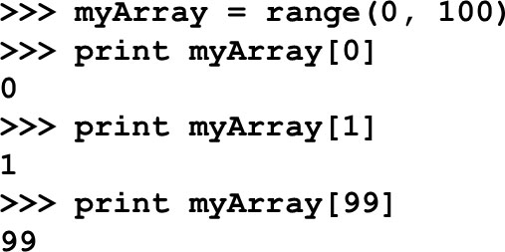
Array References
Square brackets ([ ]) are standard notation for arrays (or lists). To access a single array element at position index, we use array[index]

Slide 8
Splicing Sounds
Splicing gets its name from literally cutting and pasting pieces of magnetic tape together
Doing it digitally is easy (in principle), but painstaking
The easiest kind of splicing is when the component sounds are in separate files.
All we need to do is copy each sound, in order, into a target sound.
Here’s a recipe that creates the start of a sentence, “Guzdial is …” (You may complete the sentence.)

Slide 9
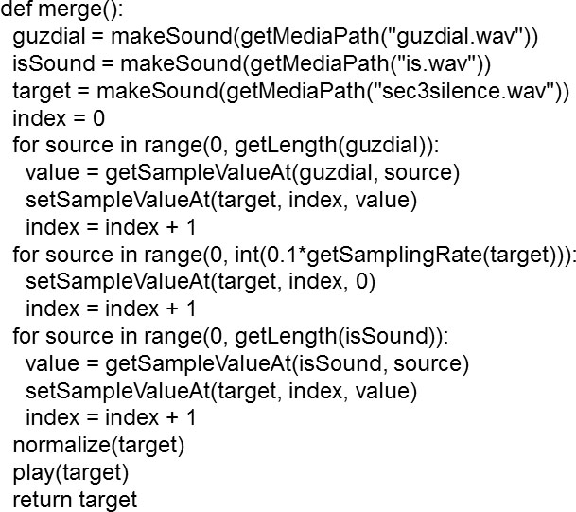
Splicing Whole Sound Files

Slide 10
Clicker: What Additional Functions Must be in the File for that Program to Work?
normalize()
play()
getMediaPath()
maximize()

Slide 11
How it Works
Creates sound objects for the words “Guzdial”, “is” and the target silence
Set target’s index to 0, then let each loop increment index and end the loop by leaving index at the next empty sample ready for the next loop
The 1st loop copies “Guzdial” into the target
The 2nd loop creates 0.1 seconds of silence
The 3rd loop copies “is” into the target
Then we normalize the sound to make it louder

Slide 12
Splicing Words into a Speech
Say we want to splice pieces of speech together:
We find where the end points of words are
We copy the samples into the right places to make the words come out as we want them
(We can also change the volume of the words as we move them, to increase or decrease emphasis and make it sound more natural.)

Slide 13
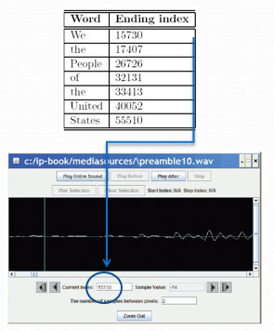
Finding the Word End-Points
Using MediaTools and play before/after cursor, we can figure out the index numbers where each word ends
We want to splice a copy of the word “United” after “We the” so that it says, “We the United People of the United States”.

Slide 14
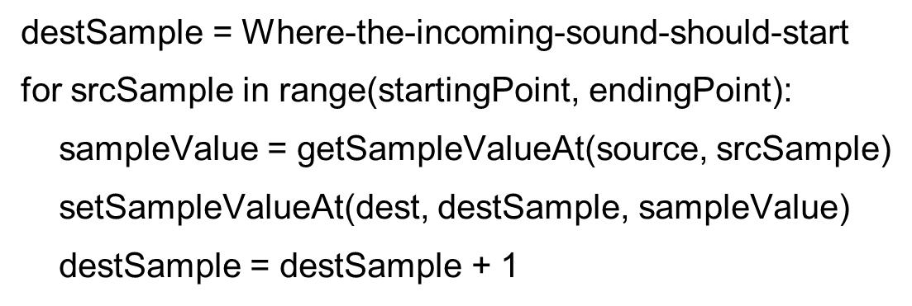
Now, It’s all about Copying
We have to keep track of the source and target indices, srcSample and destSample

Slide 15
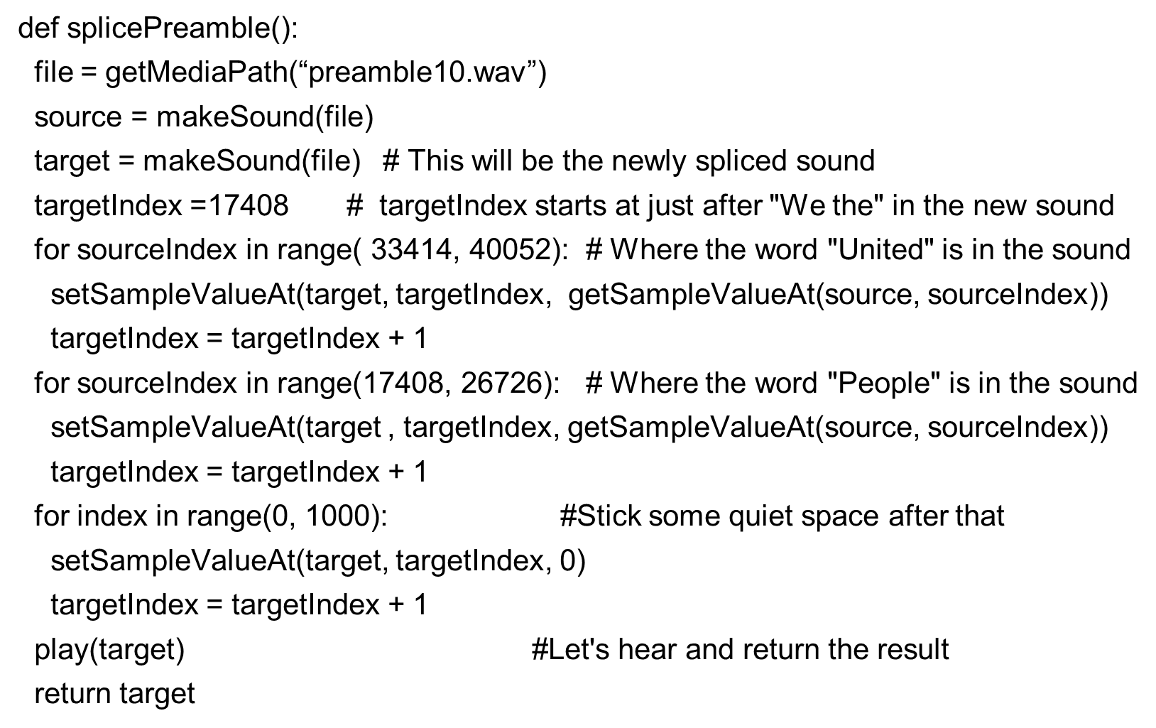
The Whole Splice

Slide 16
What’s Going on Here?
First, set up a source and target.
Next, we copy “United” (samples 33414 to 40052) after “We the” (sample 17408)
That means that we end up at 17408+(40052-33414) = 17408+6638=24046
Where does “People” start?
Next, we copy “People” (17408 to 26726) immediately afterward.
Do we have to copy “of” to?
Or is there a pause in there that we can make use of?
Finally, we insert a little (1/1441th of a second) of space – 0’s
Word | Ending Index
We | 15730
the | 17407
People | 26726
of | 32131
the | 33413
United | 40052
States | 55510

Slide 17
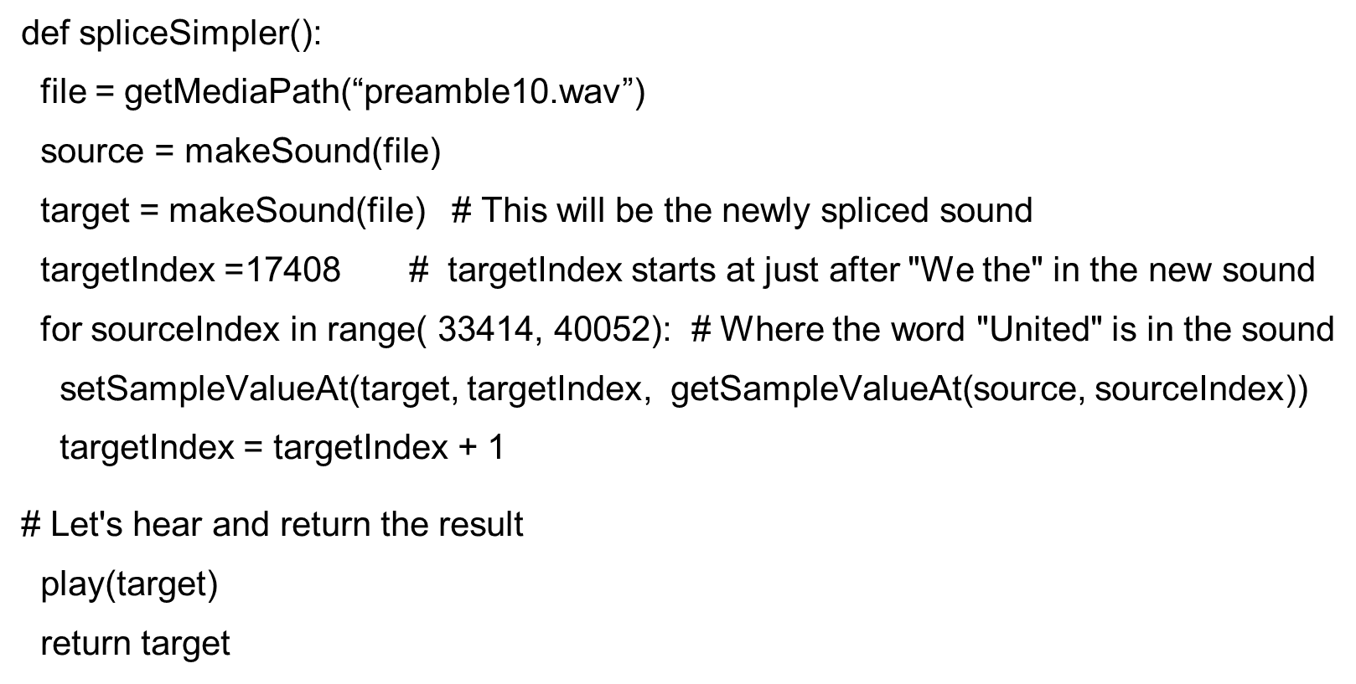
What if we didn’t do that Second Copy? or the Pause?

Slide 18
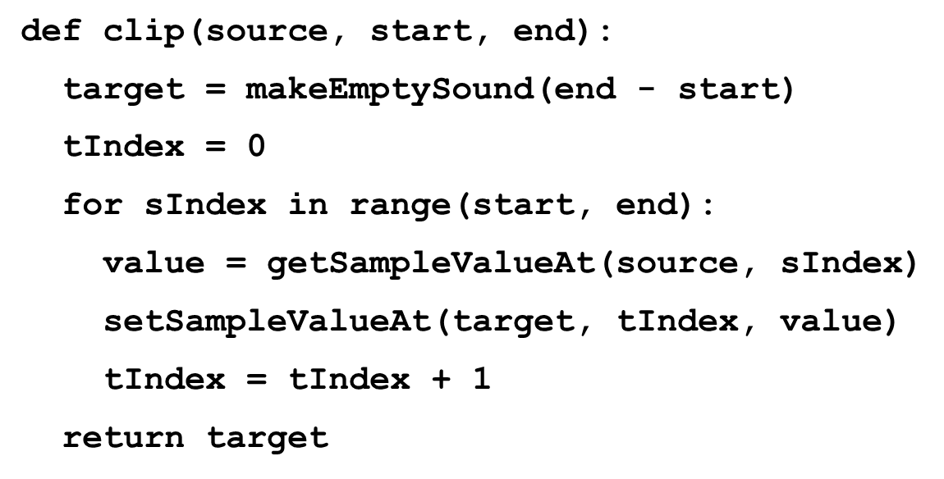
General Clip Function
We can simplify those splicing functions if we had a general clip method that took a start and end index and returned a new sound clip with just that part of the original sound in it.

Slide 19
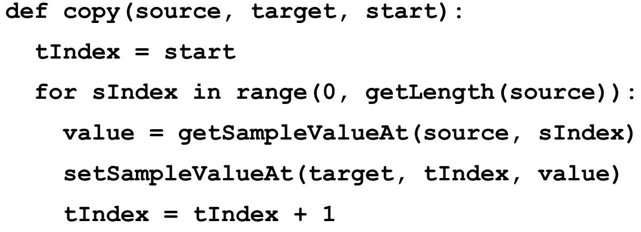
General Copy Function
We can also simplify splicing if we had a general copy method that took a source and target sounds and copied the source into the target starting at a specified target location.

Slide 20
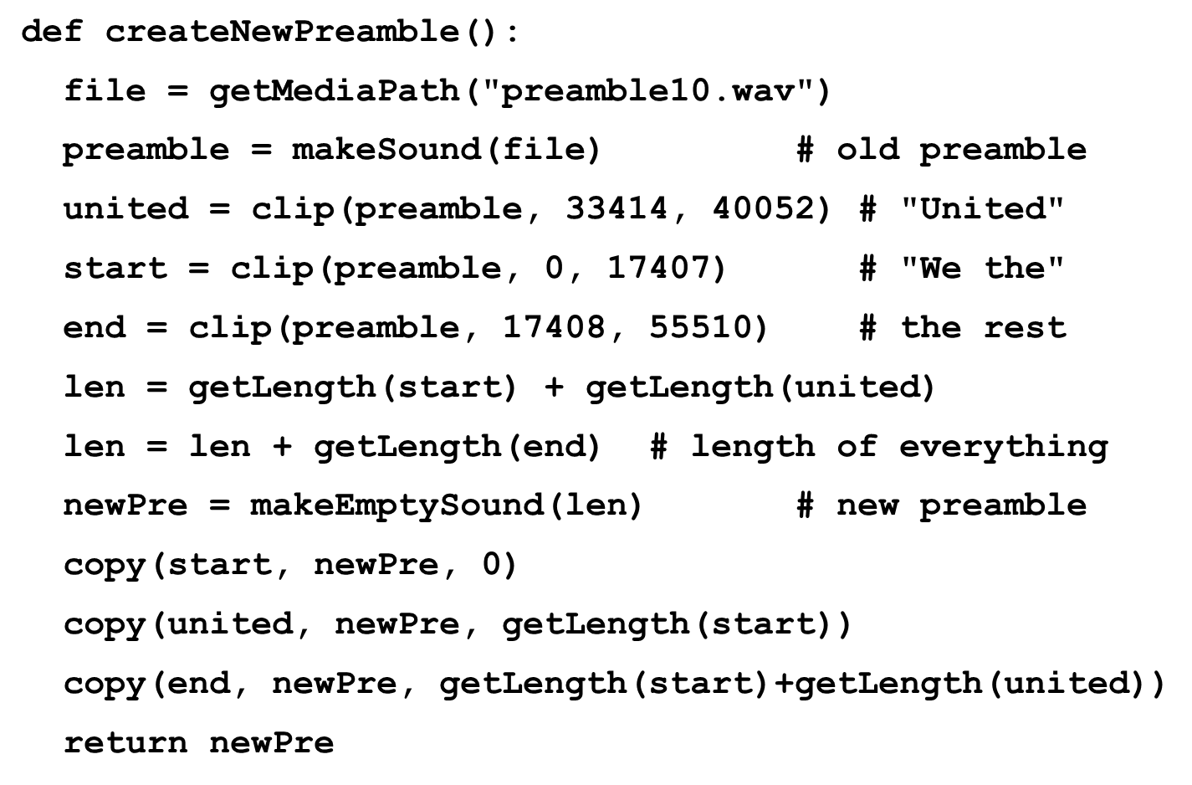
Simplified Preamble Splice
Now we can use these functions to insert “United” into the preamble in a much simpler way.

Slide 21
Changing the Splice
What if we wanted to increase or decrease the volume of an inserted word?
Simple! Multiply each sample by something as it’s pulled from the source.
Could we do something like slowly increase volume (emphasis) or normalize the sound?
Sure! Just like we’ve done in past programs, but instead of working across all samples, we work across only the samples in that sound!

Slide 22
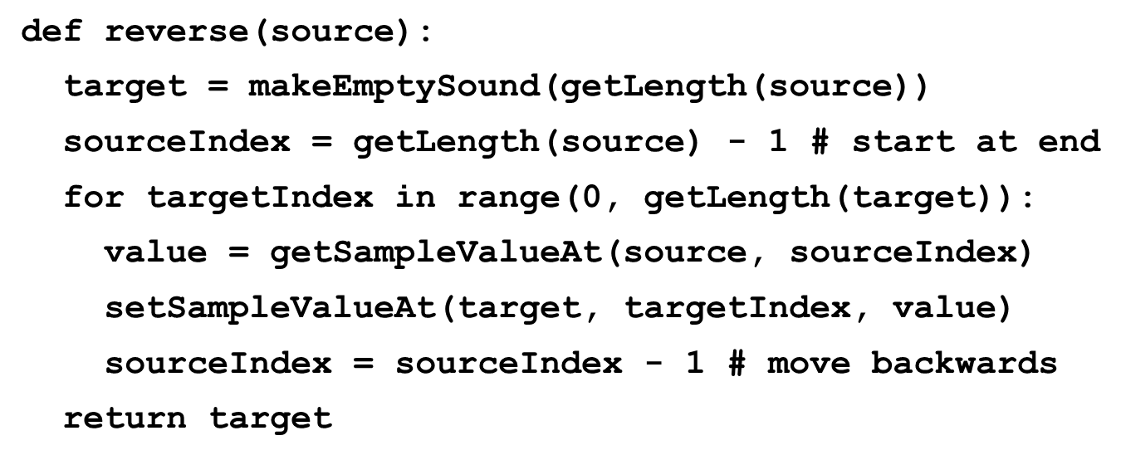
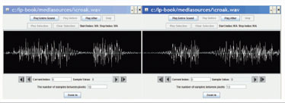
Reversing Sounds
We can also modify sounds by reversing them

Slide 23
Clicker: What does makeEmptySong Take as Input?
Based on that last program, what do you think makeEmptySong takes as input?
Number of samples needed in the new song.
Number of bytes needed in the new sound.
Number of seconds needed in the new song.
A song to copy.

Slide 24
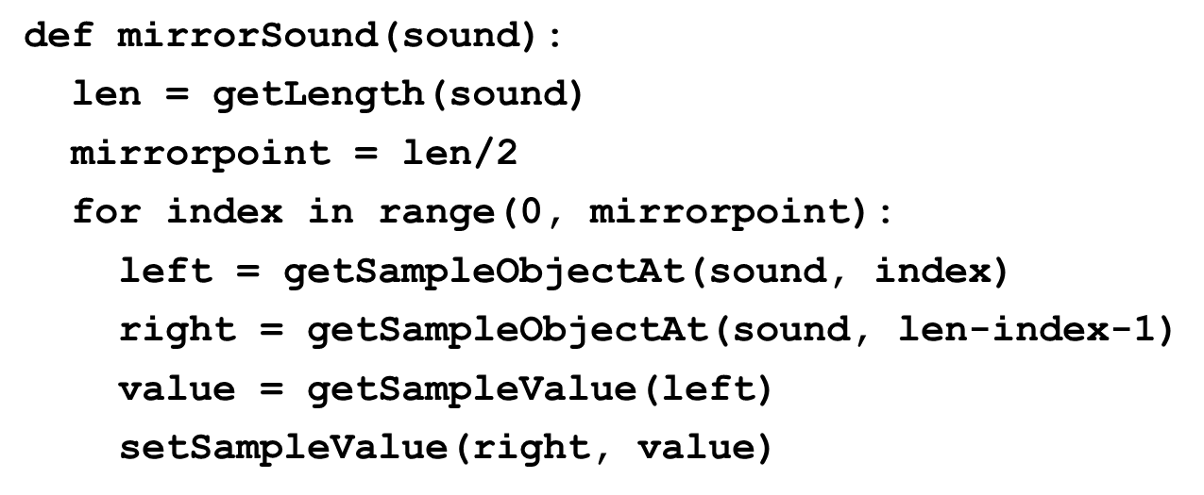
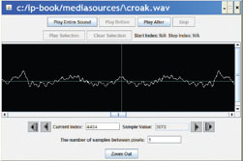
Mirroring
We can mirror sounds in exactly the same way we mirrored pictures

Slide 25
Functions and Scope
Defined:
Let’s call the variable that represents the input a “parameter variable”
Key idea:
The parameter variable in a function has Nothing to do with any variable (even with the same name) in the Command Area – or anywhere else.
Parameter variables are Local to the function.
We say that it’s in the function’s Scope.

Slide 26
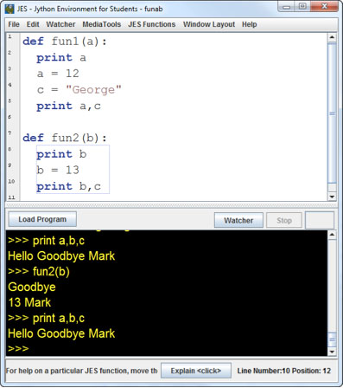
Think This through:

Slide 27
Values are Copied into Parameters
When a function is called, the input values are copied into the parameter variables.
Changing the parameter variables can’t change the input variables.
All variables that are local disappear at the end of the function.
We can reference variables external to the function, if we don’t have a local variable with the same name.

Slide 28

Parameters as Objects
Note: Slightly different when you pass an object, like a Sound or a Picture.
You still can’t change the original variable, but you’ve passed in the object. You can change the object.
increaseRed() can’t change the variable p, but it can apply functions and methods to change the picture that p references.
That picture, the object, is the value that we passed in to the function.

Slide 29

Copyright

